Slide 1

Info 2312

Slide 2
Info 2312

Slide 3
INFO2312: DataBase Systems2 Academic System – Jaegar State University forms Academic System
Group members
Gurnoor Kaur (100442682)
Sukhdeep Singh (100447918)
Jashanpreet Kaur (100448444)
Kartik Palta (100447666) - TeamACAD

Slide 4
Academic System
Introduction

Slide 5
TABLE OF CONTENT
ER-Diagram
Relational Schema
Academic System Database
4 Useful Queries

Slide 6

Academic System’s ER-Diagarm

Slide 7
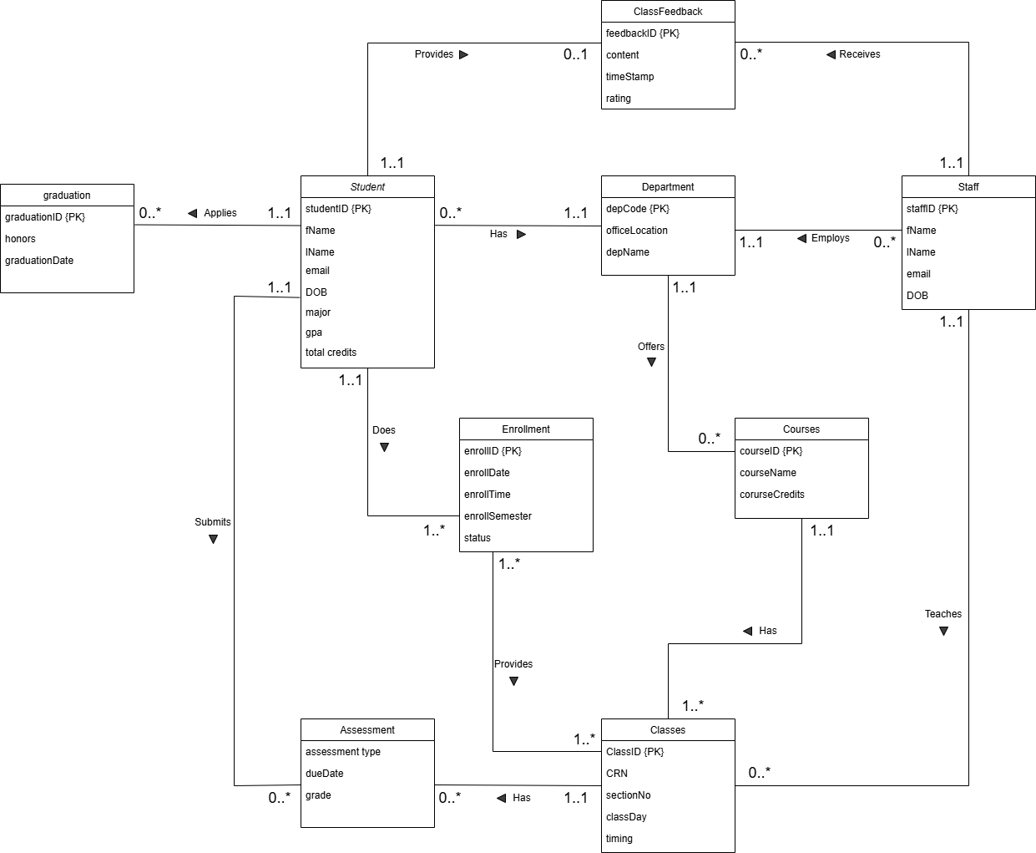

Slide 8
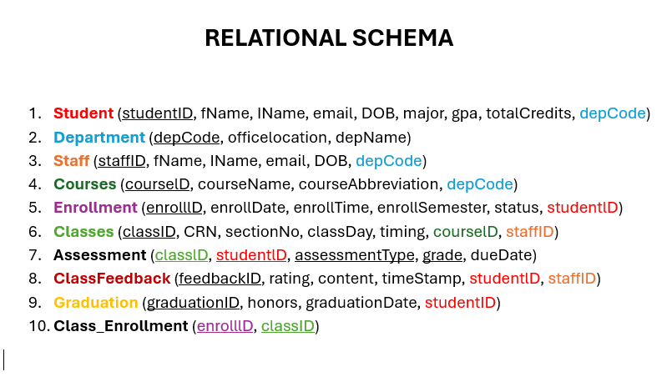

Slide 9
Academic System Database
&
SQL Queries

Slide 10
📘 Summary of Work
Throughout this project, we successfully:
Designed and implemented a normalized relational database for a university system.
Populated all tables with realistic sample data (20+ students, 10+ classes, instructors, courses, assessments, and feedback).
Defined primary and foreign keys to enforce data integrity.
Developed multiple SQL queries to gain insights from real academic operations.
🧩 Challenges and Lessons Learned
Challenge: Ensuring consistency in foreign key constraints across related tables maintaining Referencial Integrity.
Lesson: Carefully sequencing insert statements is crucial to prevent integrity errors.
We also learned how to transform real-world rules into database logic using joins, aggregations, and filters to extract insights.

Slide 11

Thank You

